Slide 1

GST (GOODS & SERVICE TAX) by Top GST Experts
    © Prepared & Presented by TOP GST EXPERTS
    CA MILIN SHAH

Slide 2

Basics about GST
What is GST??
GST is a destination based tax on consumption of goods and services. It is proposed to be levied at all stages right from manufacture up to final consumption with credit of taxes paid at previous stages available as setoff. In a nutshell, only value addition will be taxed and burden of tax is to be borne by the final consumer.
Taxable goods and services are not distinguished from one another and are taxed at a single rate in a supply chain till the goods or services reach the consumer.

Slide 3
Why GST is Necessary ?.
Issue in existing tax regime
GST tax System_ benefit
Cascading Effect _ Means tax on tax
Multiple tax leads increase in compliance cost
Due to heavy cost exporters are not able to compete with world
Was Difficult to curb black money”& Corruption
Inefficient dispute resolution system in the current indirect tax regime ( SEZ- Export Zone better in China)
All Major Indirect Taxes are subsumed into one Tax. Saving in compliance & procedural cost for businessman as well for government
Free flow of Input Tax credit means no cascading effect _ Tax on Tax
Transparency in Tax flow ( Everything will be online through GSTN)eventually help to curb black money & corruption
Effective dispute resolution system will attract foreign investor
Indian market will be more competitive with the world
Overall Growth in economy

Slide 4
GST Bill Finalized & Input credit system
CGST
CGST
IGST
SGST
SGST
IGST
UTGST
IGST
CGST
SGST
IGST

Slide 5
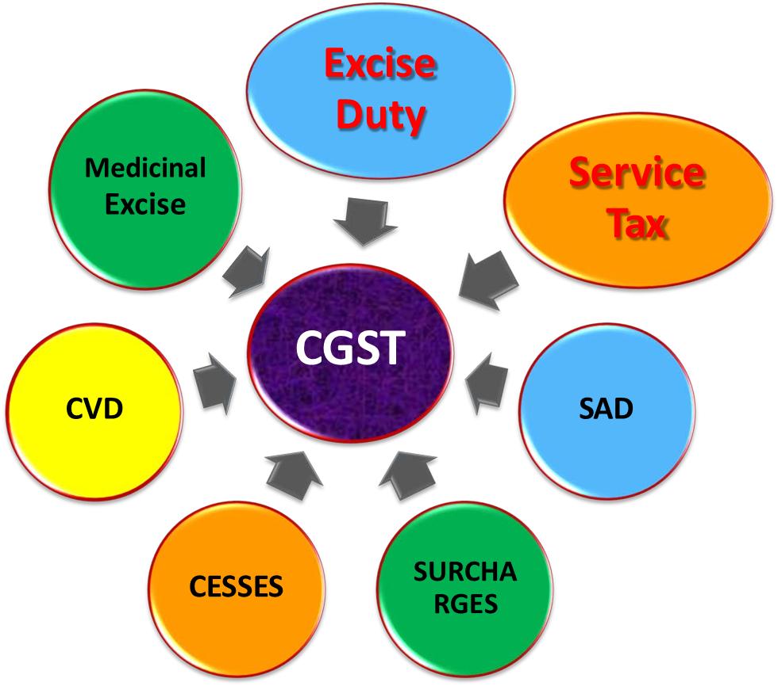
Taxes subsumed under CGST

Slide 6
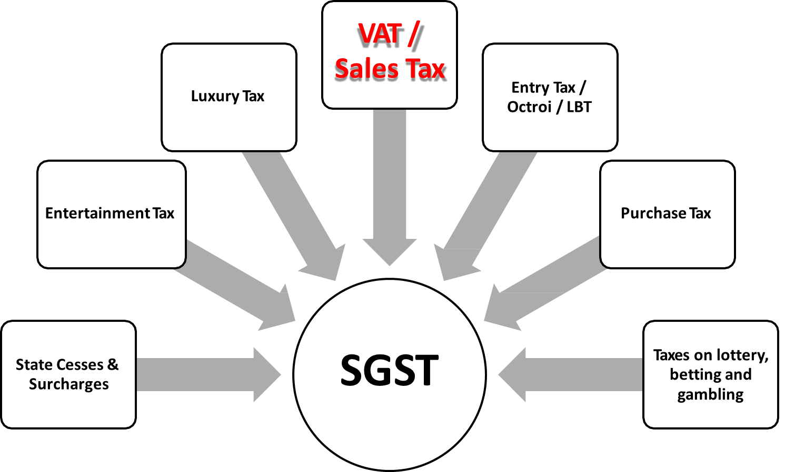
Taxes subsumed under SGST

Slide 7
Taxes not subsumed under GST
Basic Custom Duties
Excise on liquor
Property Tax
Stamp Duty
Tax on sale/consumption of electricity

Slide 8
Products not covered under GST
Petroleum Crude
Motor Spirit(Petrol)
High Speed diesel
Natural Gas
Aviation turbine fuel
Liquor
Note : -What will be status of Tobacco and Tobacco products under the GST regime?
Ans. Tobacco and tobacco products would be subject to GST. In addition, the Centre would have the power to levy Central Excise duty on these products.

Slide 9
When GST charge is come into picture : “SUPPLY”
Under GST Regime, Supply is the Taxable Event.
Supply is carried out for Consideration or in course of Furtherance of Business
Supply is Taxable as per Time of Supply and Rate during the Time of Supply.
Valuation of Supply is Transaction Value.

Slide 10
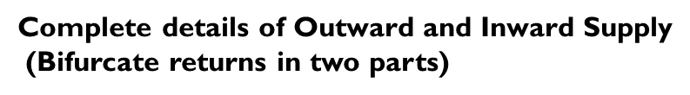
Recent Imp. GST Amendments
1. Amendments in Returns
Old returns
Amendments in returns
GST RET- 1
GST ANX - 1
GST ANX -2
GSTR 3B : - Summery of Outward Supplies and ITC along with Payment return
GSTR 1: - Invoice wise outward supply details
GSTR 2 : - Auto generate ITC/purchase, but not able to implement due to practical issues
Annexure of Outward Supplies
Annexure of Inward Supplies

Slide 11
Old Return-filing System | New Simplified Return System
Taxpayers considered small if turnover is up to Rs 1.5 crore in the preceding financial year, otherwise considered large taxpayers | Taxpayers considered small if turnover is up to Rs 5 crore in the preceding financial year, otherwise considered large taxpayers
Multiple return forms to be filed depending on the category of taxpayers, such as – GSTR-1, GSTR-4, GSTR-5, GSTR-6, GSTR-7, etc | A single simplified main return form GST RET-1 containing 2 annexures GST ANX-1 and GST ANX-2 to be filed by all categories of taxpayers
Revenue invoices can be uploaded only at the time of filing of returns of outward supplies | A mechanism for the continuous upload of revenue invoices on a real-time basis
Input tax credit could be claimed on a self-declaration basis | Input tax credit can be claimed based on invoices uploaded by the supplier
Missing invoices and amendments, if any, could only be made in the return of the following tax period | Missing invoices and amendments, if any, can be made by filing an Amendment Return
Taxpayers have to file GST returns until their registration has been cancelled, even if an application for cancellation of registration has been submitted | Registration will now be suspended, in cases where a taxpayer has applied for cancellation of registration, and returns will not need to be filed for this period

Slide 12
Other Key Amendments related to returns and forms
Facility to amend GST Returns
Upto two amendments can be filled for each tax period
Diff. of tax liability due to amendments can be paid through RET – 1A
New return system would deter habitual non-filers as auto population of Credit would stop in GST ANX-2
PMT 09 will be active , so you can transfer your Cash balance from One head to other head
For ex. You wrongly paid tax amount in CGST instead of IGST, so by this challan so that transfer to IGST head)
GSTR 1 & GSTR 3B will be continue till Sep 2020

Slide 13
Other Key Amendments
Aadhaar authentication becomes important for certain type of persons getting registered under GST.
The GST council in its 39th meeting has extended the due date of GSTR 9 and GSTR 9C annual return filing forms till 30th June 2020 for the FY 2018-19 and has extended the turnover limit to 5 crores as well
The 39th GST council also revoked all the late fees for the annual return and Reconciliation Statement for financial year 2017-18 and 2018-19 for the less than 2 crore turnover taxpayers.
GST Council, in its 35th meeting, has decided to implement a system of e-invoicing, which will be applicable to specified categories of persons. e-invoicing is not the generation of invoice on GST portal. It is a myth. e-invoicing is the submission of an already generated standard invoice on a common portal.
E – Invoice is compulsory for taxpayers having aggregate turnover more than Rs.100Cr.

Slide 14
COVID 19 Relief Measures _ Compliance Part
Relief for Compliance Related to GST in Tax Audit Report
The Government vide CBDT circular No. 10/2020 Dated 24 April 2020 deferred reporting of Compliance related to Goods and Service Tax (GST) in the income tax audit reports by a year.
The tax audit report form was amended in 2018 to include details of GST registration Including Total Turnover and Opening and Closing ITC details, however the kept under abeyance till March 2020 earlier and now again till March 2021

Slide 15
COVID 19 Relief Measures _ Compliance Part
Related to Monthly GST Returns and Payments

Slide 16
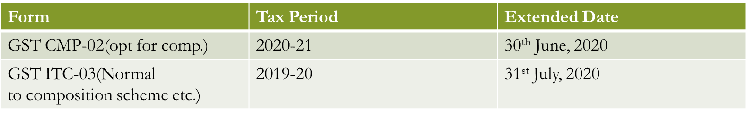
COVID 19 Relief Measures _ Compliance Part
Related to Monthly GST Returns and Payments
Normal Taxpayers wanting to opt for Composition should not file GSTR3B and GSTR 1 for any tax period of FY 2020-21 from any of the GSTIN on the associated PAN.
Compliances for Composition taxpayers
Form | Tax period | Extended Date
GST CMP-08 | Jan to March 2020 | 07.07.2020
GSTR-4 | FY 2019-20 | 15.07.2020

Slide 17
Interest Relief measures towards Late payment of GST
1. Turnover > 5 Crore
Tax period (a) | Interest not payable,if filed by (b) | Date from which interest is payable@ 9% till date of filing,if filed by 24th June, 2020 (c) | Date from which interest is payable@ 18% till date of filing,if not filed by 24th June, 2020 (d)
Feb, 2020 | 4th April, 2020 | 5th April, 2020 | 21st March, 2020
March, 2020 | 5th May, 2020 | 6th May, 2020 | 21st April, 2020
April, 2020 | 4th June, 2020 | 5th June, 2020 | 21st May, 2020

Slide 18
Interest Relief measures towards Late payment of GST
1. Turnover > 1.5 Crore < 5 Crore
Tax period (a) | Interest not payable,if filed by (b) | Date from which interest is payable @18%, if not filed by dates in Column (b),for taxpayers falling in States/UT of Group 1 (c) | Date from which interest payable @18%, if not filed by dates in Column (b), for taxpayers falling in States/UT of Group 2 (d)
Feb, 2020 | 29th June, 2020 | 23rd March, 2020 | 25th March, 2020
March, 2020 | 29th June, 2020 | 23rd April, 2020 | 25th April, 2020
April, 2020 | 30th June, 2020 | 23rd May, 2020 | 25th May, 2020

Slide 19
Interest Relief measures towards Late payment of GST
1. Turnover < 1.5 Crore
Tax period (a) | Interest not payable,if filed by (b) | Date from which interest is payable @18%, if not filed by dates in Column (b),for taxpayers falling in States/UT of Group 1 (c) | Date from which interest payable @18%, if not filed by dates in Column (b), for taxpayers falling in States/UT of Group 2 (d)
Feb, 2020 | 30th June, 2020 | 23rd March, 2020 | 25th March, 2020
March, 2020 | 03rd July, 2020 | 23rd April, 2020 | 25th April, 2020
April, 2020 | 06th July, 2020 | 23rd May, 2020 | 25th May, 2020

Slide 20


COVID 19 Relief Measures _ to General Public benefit
First and big relief measures provided by the Govt is early and strict implementation of Lockdown. By this step we are in very good position to fight against this Covid 19 Pendemic
Lets have a Big clap for Governments, Doctors, Policemen, people who are transferring Essential Items at our door step & Other supporting ground staff

Slide 21
COVID 19 Relief Measures _ to General Public benefit
Cash Transfers Announcement: Rs 1,500 in three equal instalments to the Jan Dhan accounts of 20.40 crore women. Status: According to the Finance Ministry, the government credited the first instalment of Rs 500 to 97 percent of the accounts, or of 19.86 crore women, at a total cost of Rs 9,930 crore. Money would be credited to the remaining accounts soon and the total cost would be Rs 10,000 crore.
Announcement: Rs 1,000 in two equal instalments to 2.8 crore senior citizens, widows and disabled. Status: All beneficiaries received the first of the two instalments at a cost Rs 1,405 crore. The second instalment will be credited in May. Announcement: Cash handouts to farmers under the PM-KISAN scheme were to be front-loaded. Status: About 7.47 crore of the eight crore farmers have received Rs 2,000 each as on April 10. This involved a total cash outgo of Rs 14,946 crore for the government, and is part of the existing scheme. Free gas cylinders to PM Ujjwala Yojana beneficiaries for next three months.
About 80 crore poor will get 5 kg wheat or rice and 1 kg of preferred pulses free every month from April to June. Each household to be given 1 kg preferred pulse for three months.

Slide 22
COVID 19 Relief Measures _ to General Public benefit
State-run New India Assurance Company Ltd. will provide 22.12 lakh frontline healthcare workers a cover of Rs 50 lakh for 90 days starting March 2020. It covers death in line of duty during the Covid-19 pandemic. Status: Insurance scheme notified, the Finance Ministry said.
States : Apart from this, some states announced combined handouts worth Rs 3,071 crore to 2.17 crore of the 3.5 crore registered building and other construction workers. This amount comes from the 1 percent cess imposed on the cost of construction and is collected by local bodies and states.
The central government was to pay 12 percent each as employer and employee’s share of EPF for those earning a monthly wage of less than Rs 15,000. Around 79 lakh subscribers and about 3.8 lakh establishments are expected to benefit from the package involving an outgo of Rs 4,800 crore.
Advance of 75 percent of the PF amount or three months of wages, whichever is lower, from accounts. - Source: - Bloomberg

Slide 23
Associations At: -
1. Delhi | 2.Kutch
3.Surat | 4. Ahmedabad
5. Patna | 6. Pune
7.Kolkata | 8.Madhya Pradesh
9.Jaipur | 10.Nashik
11.Punjab | 12.Karnataka
13.Hyderabad | 14. Chhattisgarh
15. Chennai | 16. Kerala 17. Goa
Head Office – Mumbai:
CA MILIN SHAH (FOUNDER)
(Chartered Accountants)
Office No. 104, 1st floor, B –wing, Shankardhan Plaza, Above Yes bank, Near Mehul Talkies, Mulund west – 400080
You can directly contact us for any query at
Mobile No : - +91 9768 961 561
Email: topgstexperts@gmail.com/camilinhshah@gmail.com
Website: - www.topgstexperts.com

